Slide 1
Health and Wholeness
By Josephine Namyalo, BCH,MPH
0777730228
email:njozena@gmail.com
Topics 1, 2&3: Introduction

Slide 2
Introduction of introduction
This particular course unit is general for all under graduate students at UCU.
We can only be excellent if we are healthy and this course unit guides you on what you need to know in order for you and your community to be healthy.

Slide 3
Introduction of introduction
Please read the slides- and then the attached notes.
Most people can easily see the connection between physical and health.
They take a while to see that wholistic health also includes social, spiritual and mental wellbeing. Please pay attention to all these dimensions of health.
And then you will be good to go.

Slide 4
Some useful links to improve wholistic health
https://www.youtube.com/watch?v=0XAKqx8zYTQ
https://www.youtube.com/watch?v=p79D6u-6pN4
https://www.youtube.com/watch?v=deBntVAMgFI
https://www.youtube.com/watch?v=cEMDeiOp8X8

Slide 5
Course Overview
Introduction
Nutrition
Hygiene
Sanitation, Safe Water, Land Use
Common Occurring Illnesses
Sexually Transmitted Illnesses
Sexuality and HIV/AIDS Prevention
First Aid and Early Intervention
Maternal and Child Health
Fitness
Addiction
Leadership for a Healthy Society

Slide 6
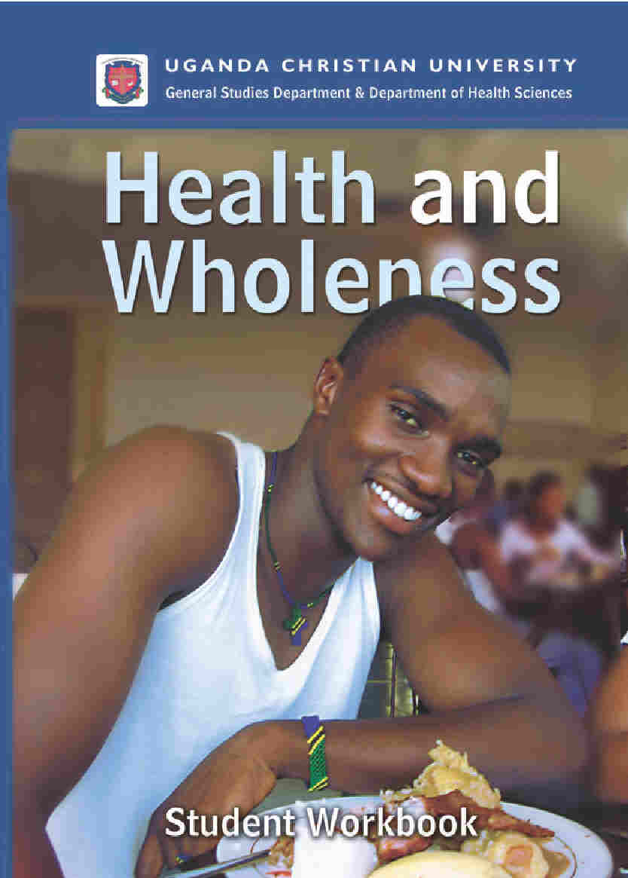

Slide 7
About your workbook
Key Definitions –most important terms
Key Concepts –most significant concepts
Readings – required readings for the week
Lesson – simplified notes
More Information – further background
Getting the Point –reinforce key concepts
The Whole Truth – Bible study questions
Reflect on This – Application questions

Slide 8
Evaluation and Assessment
10% Lecture attendance, participation
10% Assignments on moodle
40% Mid-Semester Test
40% Final Exam

Slide 9
So why are we spending a semester on HEALTH AND WHOLENESS?

Slide 10
Less Developed Countries have:
75% of world population
86% of all babies
98% of all infant/child deaths
22-50% premature mortality
31% of children are malnourished
28,000 children die daily from disease

Slide 11
Uganda’s Rank in Africa…
Indicator | Data | Compare
Life Expectancy Number of years to expect to live | Male: 62 Female: 64 63yrs | 71yr global SSH- 58yrs
Healthy Life Expectancy Number of healthy years | 49 years
Population Growth Annual increase in population | 3.% per year | Kenya -2.6, Rwanda 2.4
Dependency Ratio of population aged 0-14 and 65+ per 100 population 15-64 years | 101.6
Child mortality Children per 1000 who die <5 | 54.6/1000
Health as % of Economy (% of GDP spent on health) | 8%

Slide 12
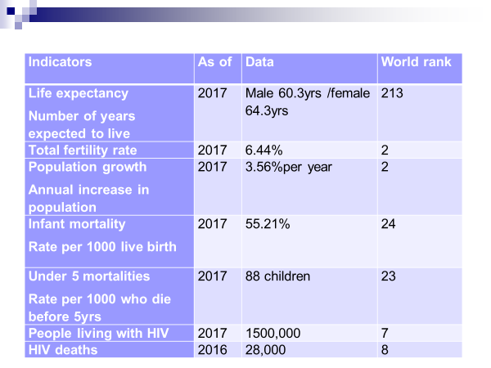
Currently selected health data for Uganda

Slide 13
Challenges to health
Lack of awareness of true information (e.g. Covid-19 is not real/it is political/does not affect young people etc.)
Cultural practices which are not healthy (e.g polygamy/crude cultural circumcision/applying cow dung on fresh umbilical stamps etc)

Slide 14
Apathy (People see problems but no body cares – e.g. look at the way people throw garbage in drainages and then floods follow)
Negative peer pressures (e.g. you cannot date without having sex! Or every body must have an expensive smart phone whatever the cost)
Lack of self esteem- (I come from a poor background- I do not deserve the best)
Poor role models/ Poor environmental conditions

Slide 15
Class discussion
Identify 5 major diseases that kill worldwide in abundance
identify health reasons why people get sick in Uganda and worldwide.
What is the commonest cause of martality among children below 5 years>

Slide 16
Every country shares or has its health problems
Poorest Countries | Developed Countries
1. Underweight 2. Unsafe sex 3. Unsafe water, sanitation 4. Indoor smoke 5. Zinc deficiency 6. Iron deficiency 7. Vitamin A deficiency 8. High blood pressure 9. Tobacco 10. High cholesterol | 1. Tobacco 2. High blood pressure 3. Alcohol 4. High cholesterol 5. High Body Mass Index 6. Low fruit/vegetable intake 7. Physical inactivity 8. Illicit drugs 9. Unsafe sex 10. Iron deficiency

Slide 17
Opportunities to improve health
Government support
Media attention
Employer health insurance programs
Private investment by families
Improving communication especially underpinned by the internet/social media

Slide 18
Holistic Health…..
Has several dimensions as seen on the next slide
You are at the Centre of holistic health supported or influenced by family, community, national and global environment-please examine next slide

Slide 19
Society
Spiritual
Nation
Economic
Culture
Self/ Family
Social
Education
Environmental

Slide 20
World Health Organization defines Health:
Health is the state of complete physical, mental, and social well-being and not merely the absence of disease or infirmity.

Slide 21
UCU defines Wholeness:
A state of personal physical, mental, spiritual, and social health, in which a person knows their value in the eyes of God, their families and their communities, and where they are empowered to make good health decisions.

Slide 22
Four Components of Wholeness (now spiritual added)
Physical
Mental
Social
Spiritual

Slide 23
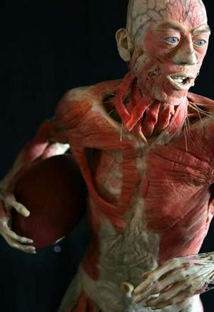
Physical systems
Skeletal-bones
Muscular- Muscles
Circulatory- Blood vessels
Respiratory- breathing system
Digestive- Alimentally canal
Nervous- brain and nerves
Reproductive- genital system

Slide 24
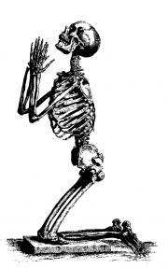
Skeletal System
The Skeleton is the name given to the collections of the bones that holds the rest of the body up.
Our skeleton protects vital organs such as the brain, the heart and the lungs.
It gives us the shape we have and allows us to move.

Slide 25
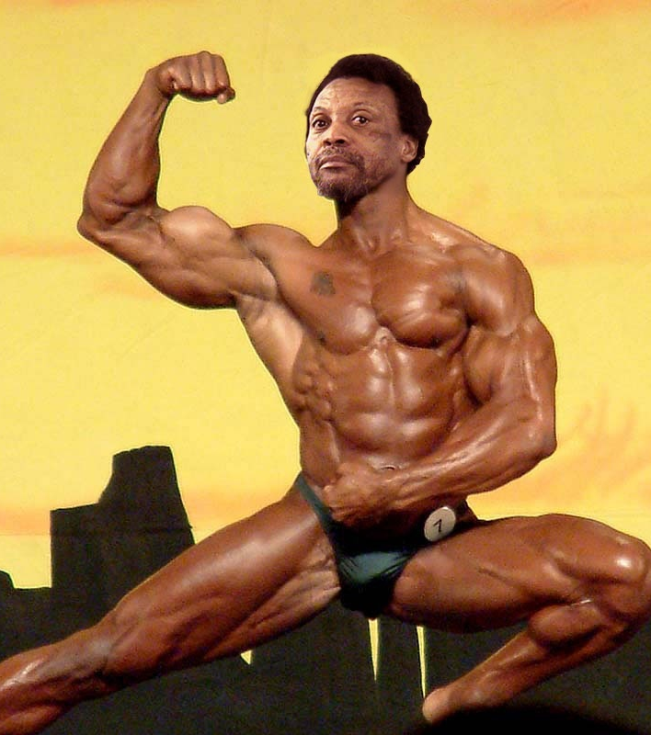
Muscular System
About half the body's weight.
Muscles allow us to move.
Special tissues shorten when they receive a signal from the brain.
Attached to bones by stretchy tissue called tendons. When muscles contract, they pull on the tendons which pull on the bones and cause our limbs to move.

Slide 26
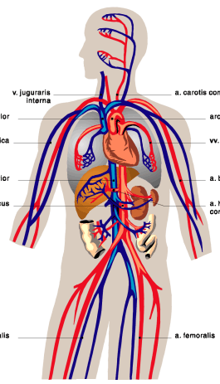
Circulatory System
Typical person has around 4-5 litres of blood.
Blood transports oxygen and nutrients to the body's cells, and carries waste materials away.
Blood carries substances called hormones, which control body processes, and antibodies to fight invading germs.
The heart pumps the blood.

Slide 27
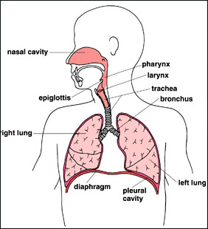
Respiratory System
Deals with breathing.
When we breathe, the body takes in the oxygen that it needs and removes the carbon dioxide that it doesn't need.

Slide 28
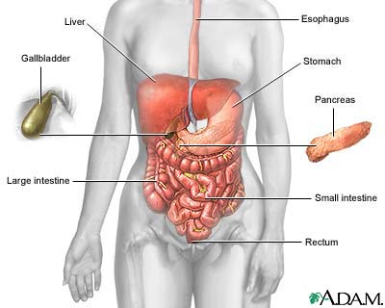
Digestive System
Food provides fuel to live, energy to work and play, and the raw materials to build new cells.
All the different varieties of food we eat are broken down by our digestive system and transported to every part of our body by our circulatory system.

Slide 29
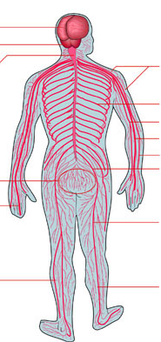
Nervous System
The Nervous System is the most complex and delicate of all the body systems.
The brain is at the centre of the nervous system. It sends and receives messages through a network of nerves. This network can be explained as similar to a road network.

Slide 30
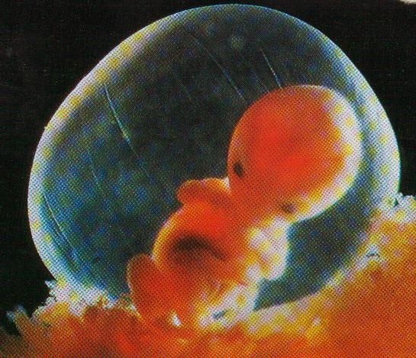
Reproductive System
Men: testicles produce sperm which are emitted through the penis during sex.
Women: produce an egg roughly each month, which can be met in the uterus by a sperm and planted in the uterus wall.

Slide 31
Emotional/Mental:
How we think or feel about
ourselves, our environment,
our situation in life

Slide 32
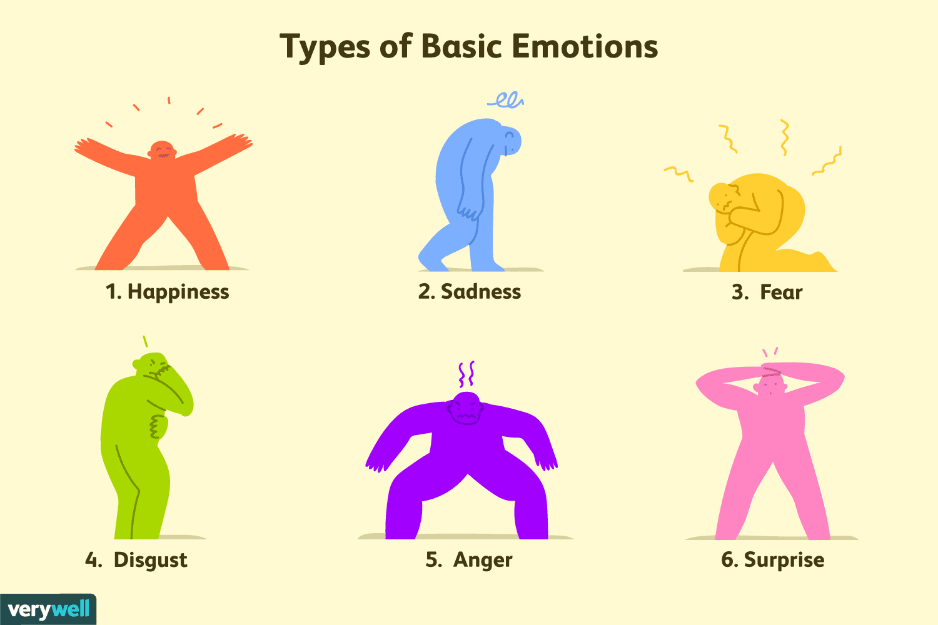
Examples of basic emotions Sources: https://www.verywellmind.com/an-overview-of-the-types-of-emotions-4163976

Slide 33
Emotional/mental factors
Attitudes and beliefs
Perceptions of self in relation to other people, nature, and God
Chemical balances in your brain
Learned patterns of thinking, behavior
Unlearned instincts

Slide 34
Social: about Relationships
Family
Friends
Communities
Society

Slide 35
Social Factors
Cohesion
Boundaries
Roles
Intimacy

Slide 36
Emotional
Loving Others
Social
Self Acceptance
Freedom
To be Needed
Acceptance
Literacy
Self-Esteem
Relationships
Stability
Intimacy
Role in Society
Holistic Health
Life in Boundaries
Purpose
Rest
Safety
Nutrition
Relationship with God
Exercise
Education
Stewardship
Sanitation
Discipleship
Agriculture
Obeying God
Clean water
Spiritual Education
Medical Care
Immunization
Growing with God
Physical
Spiritual
Preventing Disease
Evangelism
Shelter

Slide 37
Spiritual: you and God!
Your relationship with God
Your core values
Your sense of God-filled purpose in life

Slide 38
The Whole Truth
Mark 12:28 … "Of all the commandments, which is the most important?" 29 "The most important one," answered Jesus, "is this: `Hear, O Israel, the Lord our God, the Lord is one. 30 Love the Lord your God with all your heart and with all your soul and with all your mind and with all your strength.' 31 The second is this: `Love your neighbour as yourself.' There is no commandment greater than these."

